Slide 1
Space and Time
October 29, 2019
UCAR
Max Plank Institute

Slide 2
What drives changes in ecosystem processes over space and time?

Slide 3
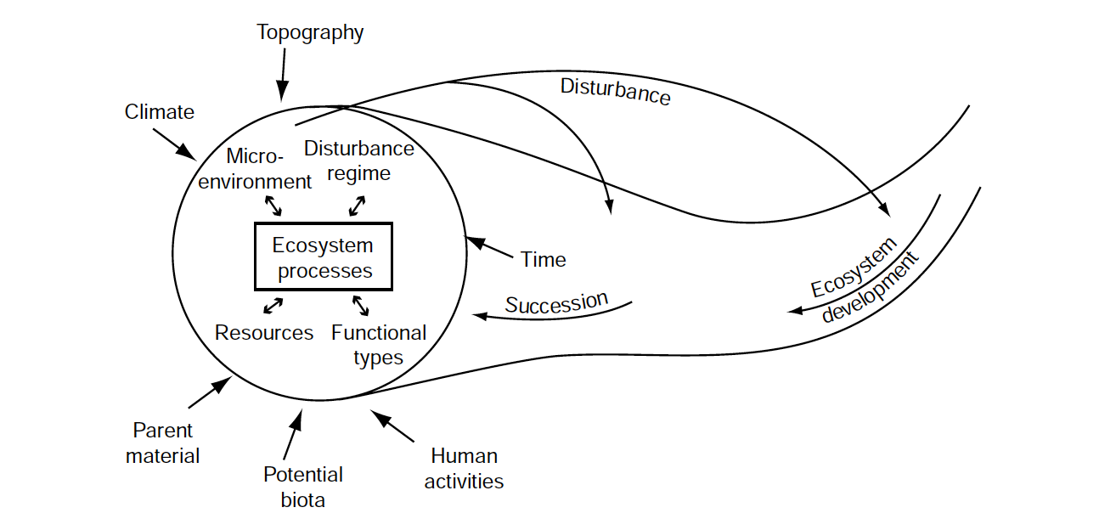
In your book, but modified from Chapin et al. (2006)

Slide 4
Temporal dynamics: Resilience

Slide 5
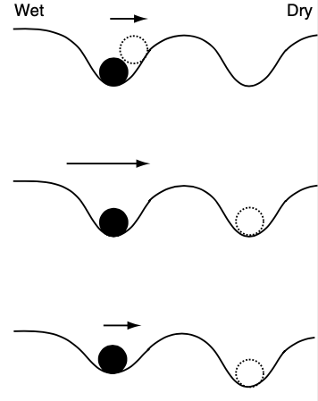
Depth of cup defines resilience of ecosystem
Length of arrow defines the strength of disturbance

Slide 6
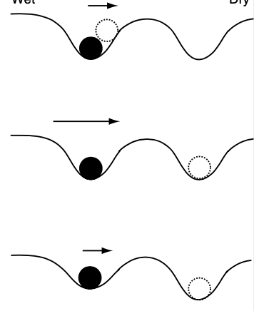
Resilient, weak disturbance
Resilient, strong disturbance
Not resilient, weak disturbance

Slide 7
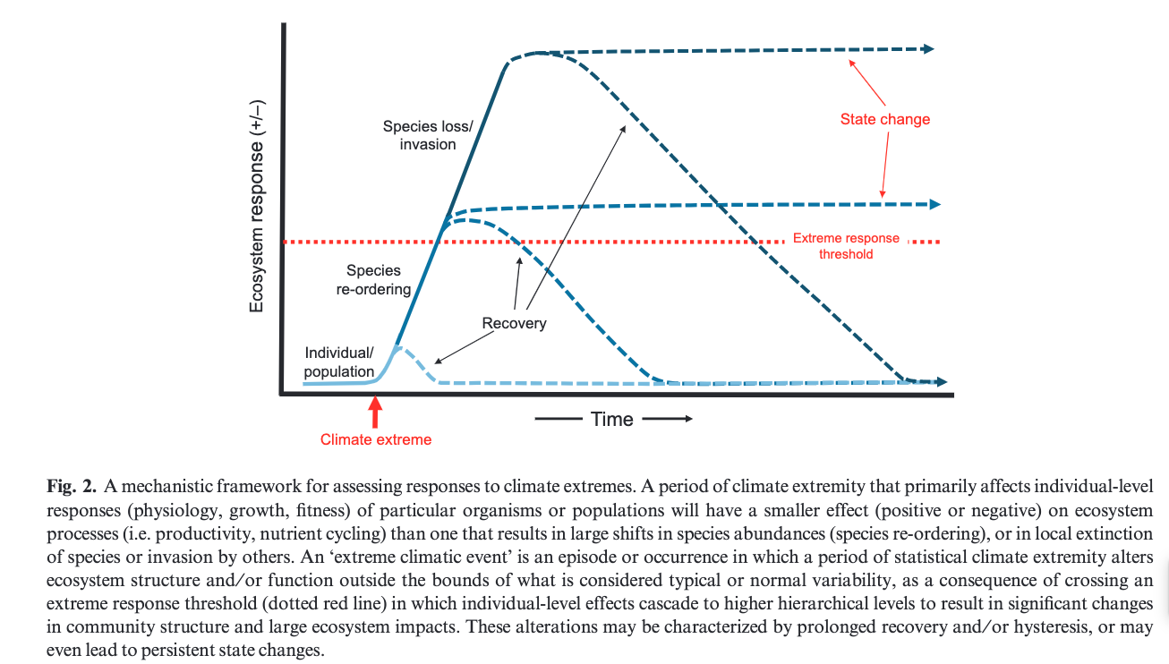
MD Smith (2011) J Ecology

Slide 8
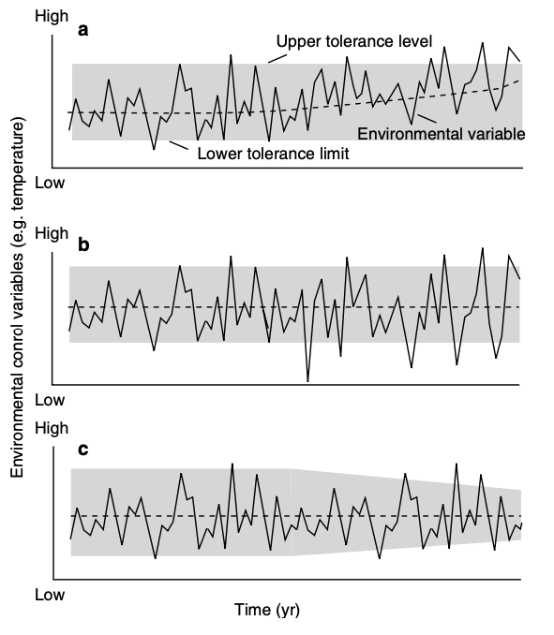
Range of resilience defines response
Directional shift in env. = more time outside range
More variable env. = more time outside range
Change in range = more time outside range

Slide 9
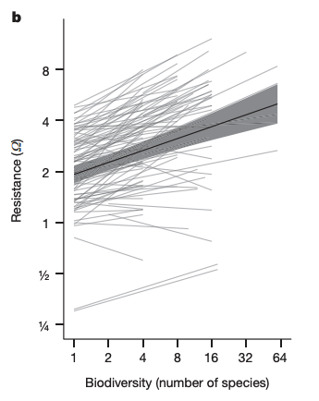
Ecological community defines response
Isbell et al. (2015) Nature

Slide 10
Temporal dynamics: History

Slide 11
It is important to understand the natural trajectory of a system to fully understand impact of a change

Slide 12
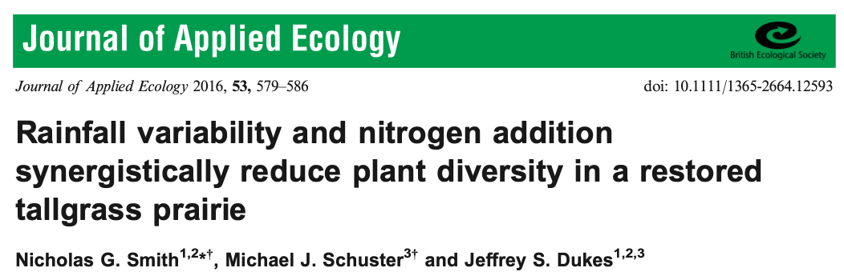
It is important to understand the natural trajectory of a system to fully understand impact of a change

Slide 13
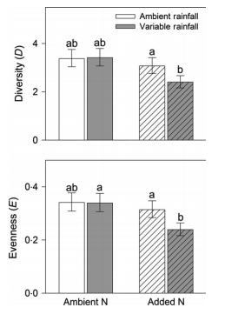
Smith et al. (2016) J Applied Ecology

Slide 14
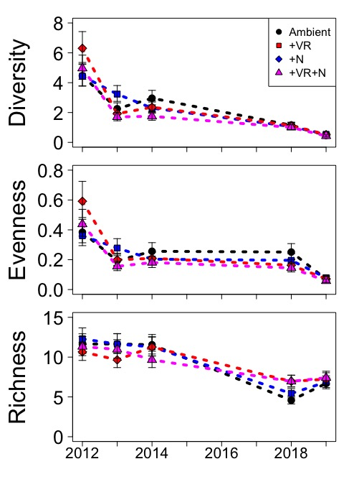
Treatments initially decreased diversity, but whole system was headed in that direction
Ploughe et al. (in review)

Slide 15
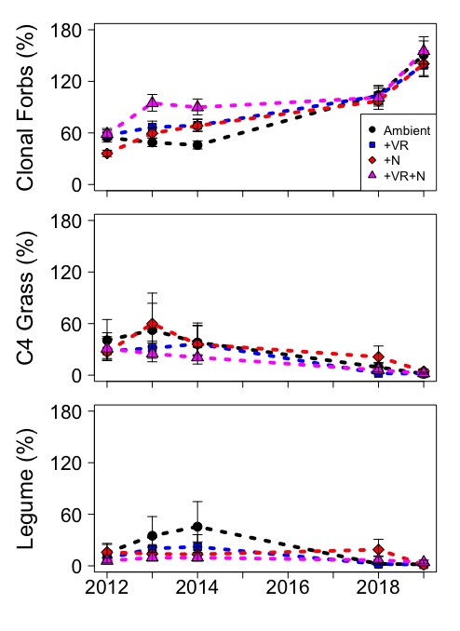
Treatments initially decreased diversity, but whole system was headed in that direction
Ploughe et al. (in review)

Slide 16
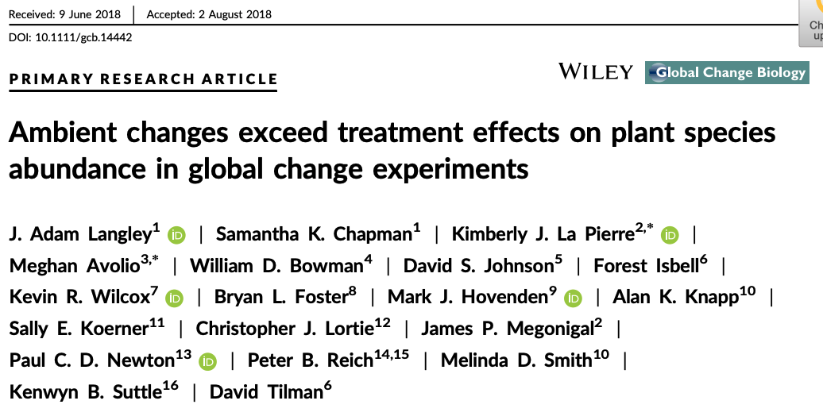

Slide 17
Temporal dynamics: Disturbance

Slide 18
Is disturbance bad for ecosystems?

Slide 19
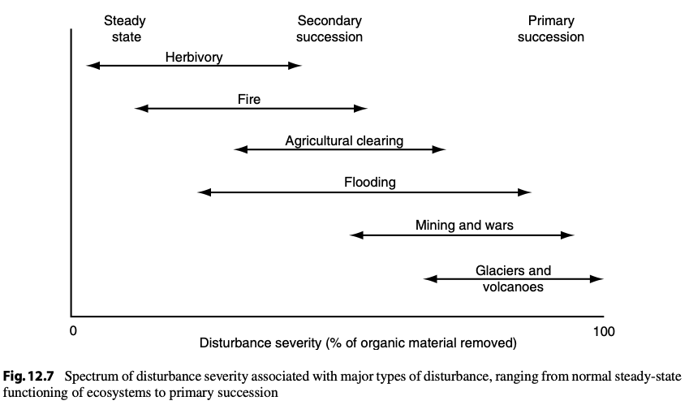

Slide 20
Types of succession
Primary
All organic matter is removed
Very little starting material
E.g., volcano, glacier
Secondary
Some organic matter remains
Some starting material
Happening all the time
E.g., fire, herbivory

Slide 21
An ecosystem’s disturbance regime
Type of disturbance
What happens?
Severity of disturbance
How much change does it cause?
Frequency of disturbance
How often does it happen?

Slide 22
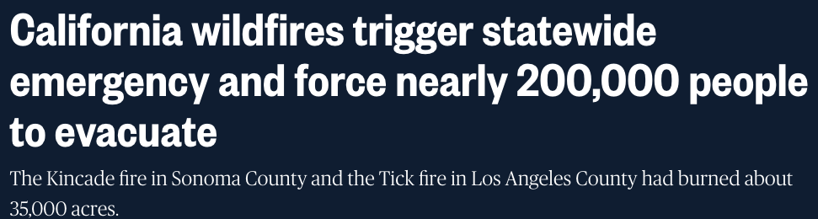
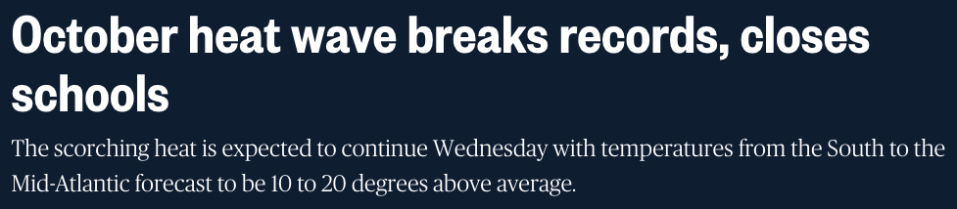
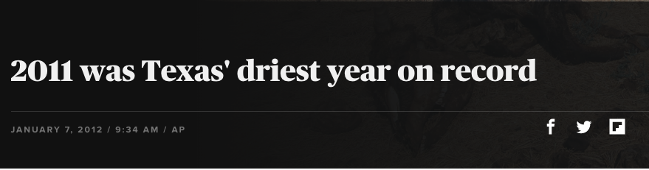
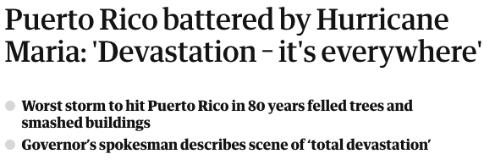
Global change is impacting disturbance regimes
NBC (10/02/19)
NBC (10/27/19)
AP/CBS
Guardian (09/21/17)

Slide 23
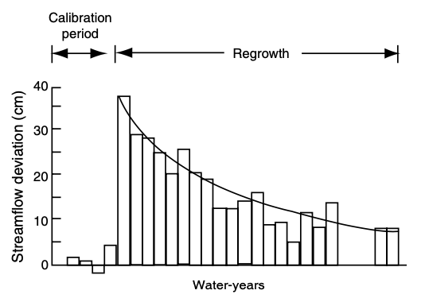
Ecosystem impacts of disturbance - water

Slide 24
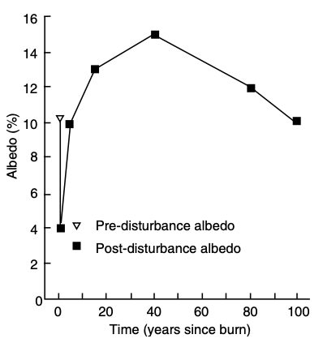
Ecosystem impacts of disturbance - energy

Slide 25
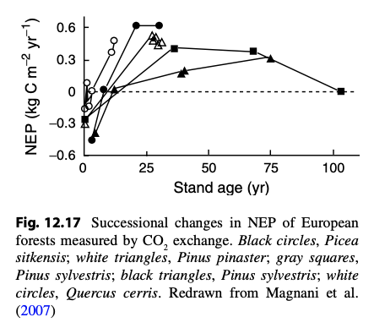
Ecosystem impacts of disturbance - carbon

Slide 26
Ecosystem impacts of disturbance - herbivory

Slide 27
Ecosystem impacts of disturbance - herbivory
Herbivory is highest during mid succession
Plant biomass is high
Plants investing in growth, not defense
Herbivores can enhance succession
Might not be good for them!
Herbivores
Early successional plants
Late successional plants
Modified from Paster et al. (1988) BioScience

Slide 28
Why is it important to consider the time scale of a study?

Slide 29
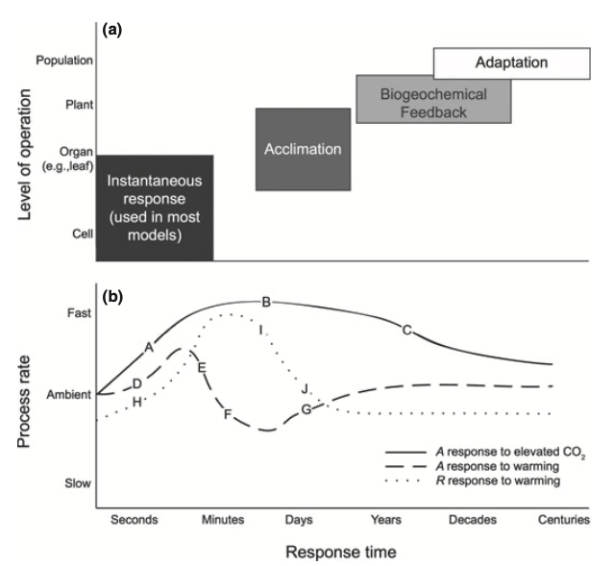
Smith and Dukes (2013)

Slide 30
Spatial dynamics: Land use and land cover change (LULCC)

Slide 31
LULCC
Change from one land type to another
Largest ongoing global change

Slide 32
Extensification
An increase in the area affected by human activities
Deforestation in Vietnam
Bourgoin et al. (2019) IJ App. Earth Obs. and Geoinformation

Slide 33
Tilman et al. (1999) PNAS

Slide 34
Intensification
Increase in resource use for new land use

Slide 35
Tilman et al. (1999) PNAS

Slide 36
Spatial dynamics: Eco-climatic teleconnections

Slide 37
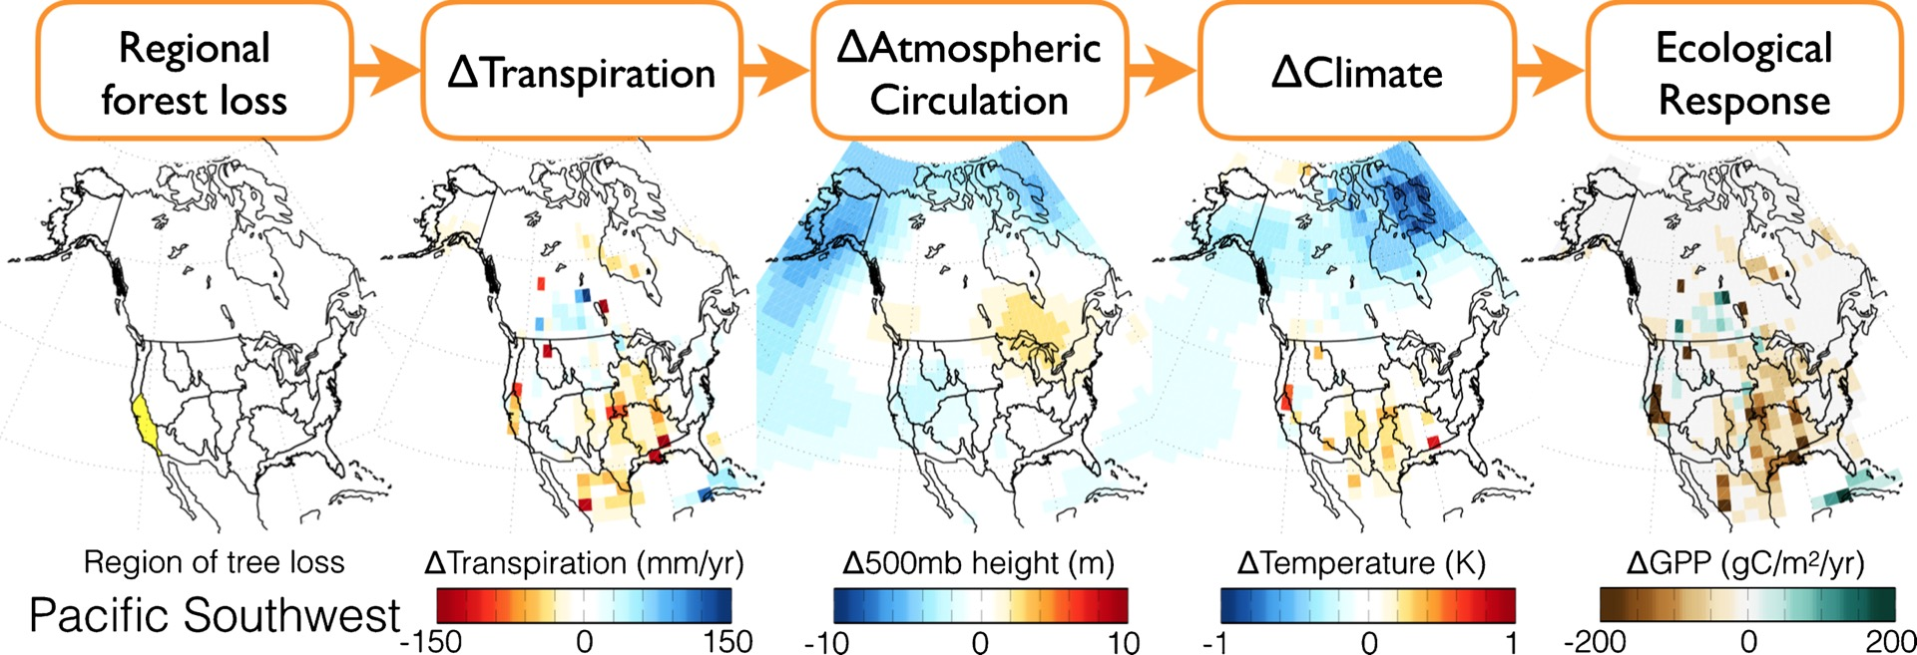
Swann et al. (2018) Env. Res. Let.

Slide 38
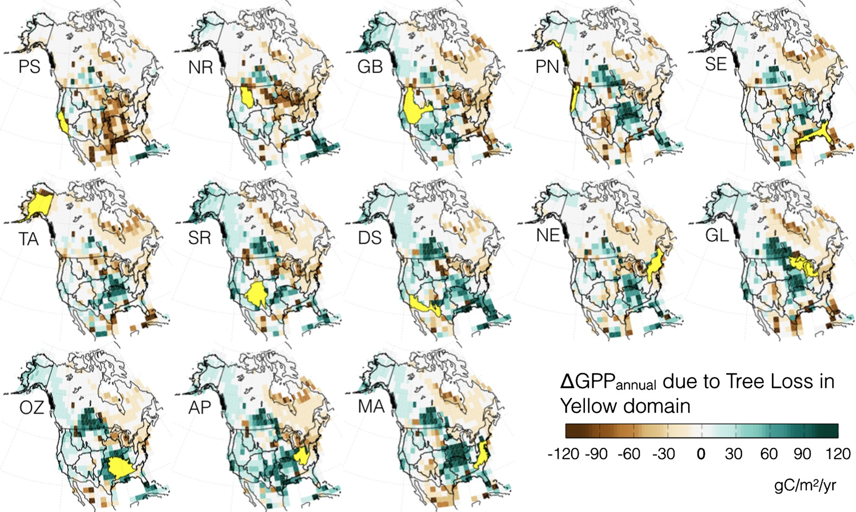
Swann et al. (2018) Env. Res. Let.

Slide 39
Spatial dynamics: coordinated research networks

Slide 40
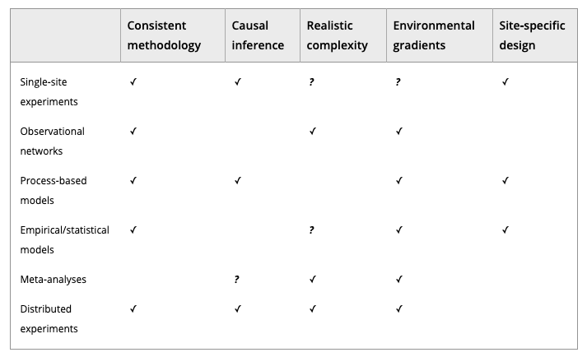
Borer et al. (2013) Meth. Ecol. Evo.

Slide 41
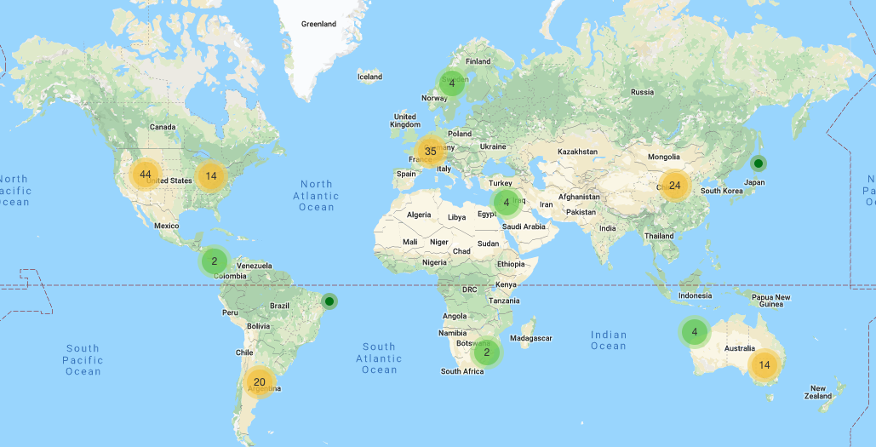
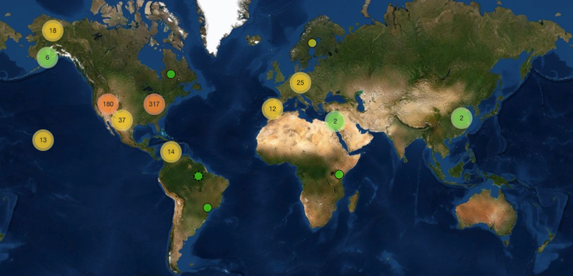
PhenoCam
Network

Slide 42
The National Ecological Observatory Network (NEON)

Slide 43
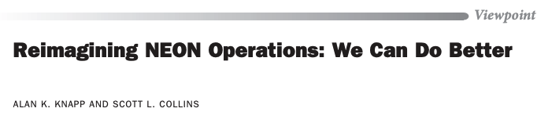
The National Ecological Observatory Network (NEON)
BioScience (October 2019)

Slide 44
How do we predict spatio-temporal changes in ecosystem processes?

Slide 45
Land surface models
UCAR

Slide 46
Earth System Models
Dr. Kaitlin Naughten

